Slide 1

Auto Anomaly
ITradeNetwork Anomaly Detection Challenge
Kyle Maxwell
Alex Lao

Slide 2

The Anomaly Detection Challenge
Dataset of supply chain network invoices for perishable goods
Nearly 500,000 samples
No examples of anomalous data

Slide 3
Autoencoders for Anomaly Detection
November 2018
Anomaly Detection using Autoencoders in High Performance Computing Systems
Andrea Borghesi, Andrea Bartolini, Michele Lombardi, Michela Milano, Luca Benini

Slide 4
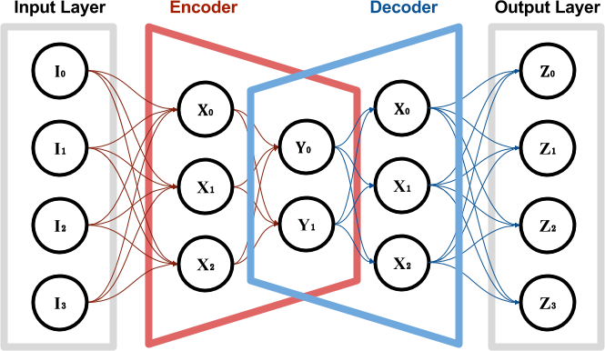
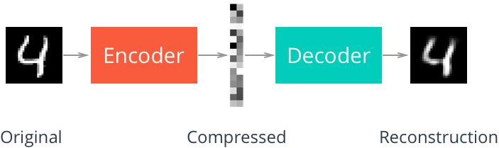

Slide 5
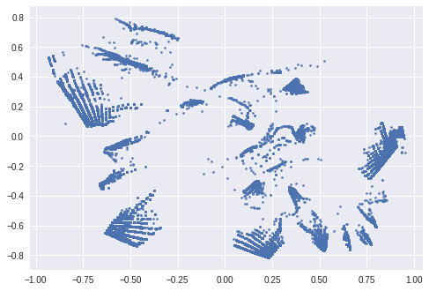
Latent Space
Data Embeddings
Manifolds

Slide 6
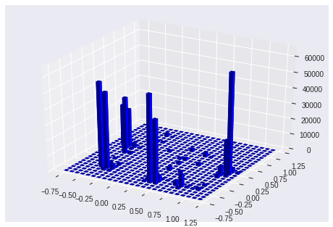
Latent Space Density Mapping
Clusters
Regularities

Slide 7
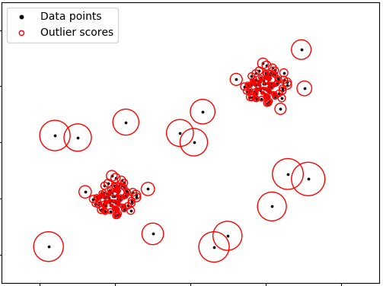
Local Outlier Factor (LOF)
Measures local density deviation with respect to its neighbors

Slide 8










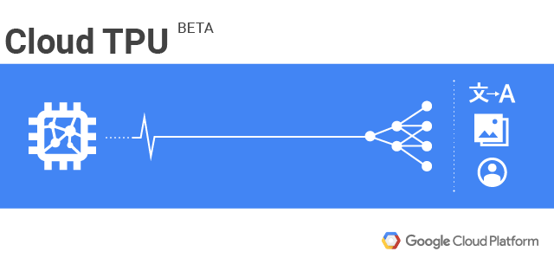


Technologies Used

Slide 9
Live Demonstration

Slide 10
The Future
Broaden the domain of Auto Anomaly
Further experimentation with Variational Autoencoders
Experimentation with Neural Attention
Extensive data cleaning
Incorporating the semantic meaning of text fields using NLP
Develop the web platform to allow for personalized data exploration

Slide 11
Thanks!
Any Questions?

